Slide 1
Real-time Steganography
By Soon Kyu Lee, Thomas Sattolo and George Shehata

Slide 2


Motivation

Slide 3


Overview Of Steganography
Original
Encoded

Slide 4
Discrete Cosine Transform Steganography
One possible steganography (stego) algorithm:
Transforms input image (cover image) into frequency domain
Message is embedded into the frequency domain data
Transforms modified data back into spatial domain, creating output image (stego image)
Offers:
High robustness against data corruption
Low detectability

Slide 5

Defining Stego Speed
Speed of a stego algorithm is measured by the amount of message data that can be embedded into a frame within the video inter-frame time (33.3 ms for 30 fps):
$Speed = \frac{bits of message embedded}{time taken for embedding} = \frac{bits embedded in image}{frame period}$
Assumptions:
Message is embedded into a constant stream of image data
Image is 1280x720 with 32-bit colour depth
Message to be embedded is always available

Slide 6
Is Steganography Viable in Software?
Software is slow; only low complexity stego schemes are possible
DCT operates at only 2.3 kbps
Many operations are parallelizable
This makes it amenable to hardware acceleration

Slide 7
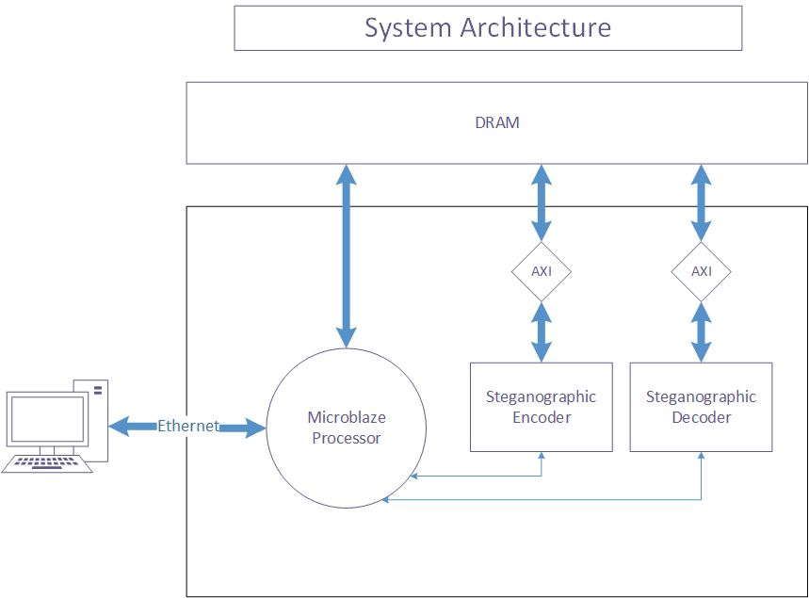


Top Level Block Diagram
Done
Start

Slide 8
ENCODER
start
Control
ready
Pixel In
DCT
Embedder
IDCT
Pixel Out
Message bit
Encryption
Message FIFO

Slide 9
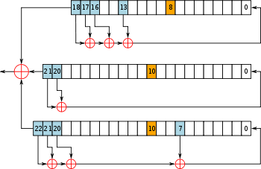
Encryption
Steganography and encryption are complementary
Cipher encryption also used in the GSM cellular telephone standard
LFSR-based stream cipher, shown on right
XORed with the message bit

Slide 10
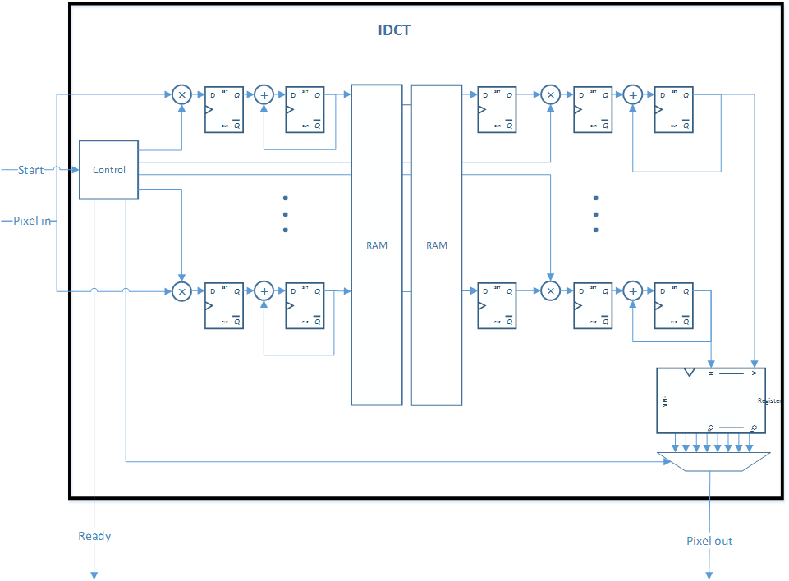
IDCT (Inverse DCT) Implementation

Slide 11
DRAM ↔ Data processing block interface
AXI Slave
Control input
To/From MicroBlaze
Read Req FSM
Read Resp FSM
AXI Master
AR
Sel
Cover Image FIFO
Valid
Cover image pixel
R
Has data
To/From DRAM
Msg FSM
4 Encoder Blocks
Message FIFO
Msg bits
Write Req FSM
AW
Has data
Stego Image FIFO
Stego image pixel
W

Slide 12
PC ↔ DRAM Interface
Originally implantation used UART, but it was very slow
Final design implements an Ethernet Server and a simple File System
An Ethernet Client is used to control the product from a command line
FPGA
Ethernet
MicroBlaze
DRAM
DRAM

Slide 13
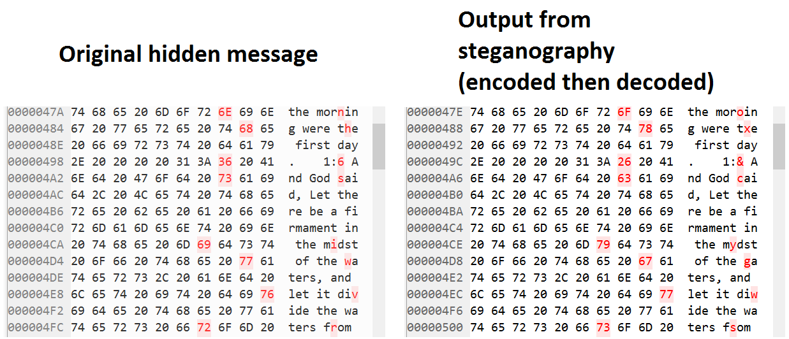
Bit-error rate and error correction

Slide 14
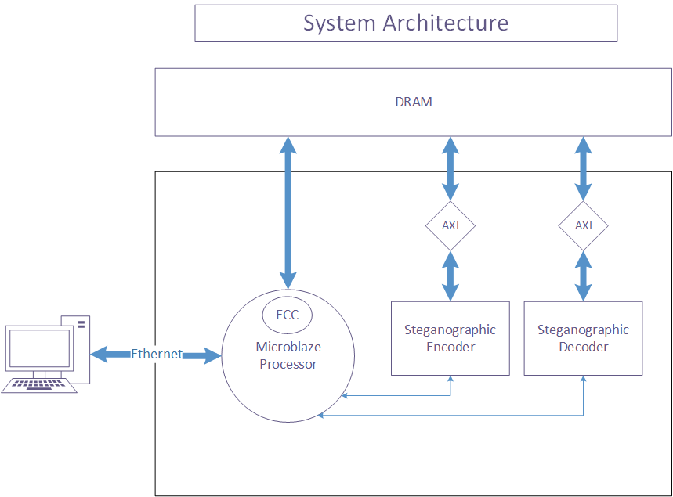
Final Block Diagram (ECC added)

Slide 15
Design Performance Summary
The encoder and decoder are able to run at 100 MHZ allowing a data throughput of 3.125 Mbps
This is a 1300x improvement over the software attained speed of 2.3 kbps

Slide 16
Design Resource Usage
Resource | Utilization
FF | 54505
LUT | 40047
Memory LUT | 2002
BRAM | 17.5
DSP48 | 104

Slide 17
What We Learned
Importance of good simulation testbenches
AXI Interfaces (lite, full, stream)
Block interface mapping and block integration
Digital signal processing cores and their implementation
Xilinx IPs and peripherals (Ethernet, UART, VDMA)

